Slide 1

A Learning Framework for Deformable Medical Image Registration
Capstone Project On
Signal Processing and Machine Learning
Department of Electrical Engineering
Indian Institute of Technology Kharagpur

Slide 2
PRESENTED BY
AMUDALA RAMYASRI – 23EE65R14
SWARNIM SRIVASTAVA – 23EE65R10
MANISH BHATI– 23EE65R23

Slide 3
Contents:
INTRODUCTION
METHOD
1. UNet Architecture
2. Spatial Transformation Function
3. Loss Functions
EXPERIMENTS
1. Dataset
2.hyperparameters
3.Model summary
RESULTS
CONCLUSION
REFERENCES

Slide 4
Introduction:
Image registration:
Involves aligning a "fixed" image with a "moving" image by determining the transformation that best matches corresponding features or intensities between them.

Slide 5
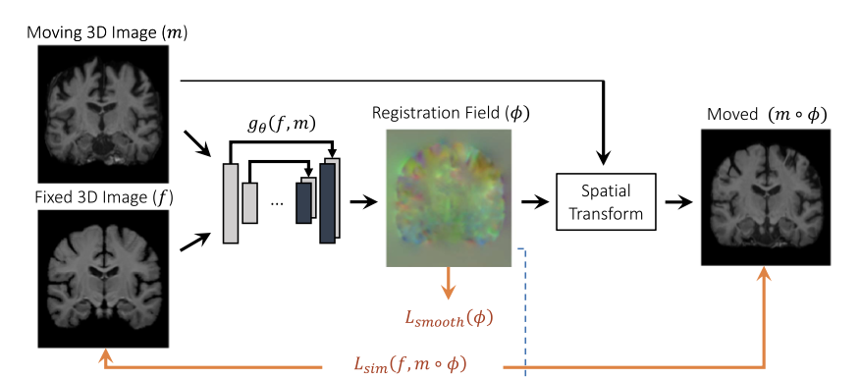
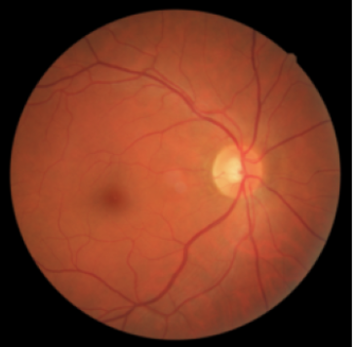
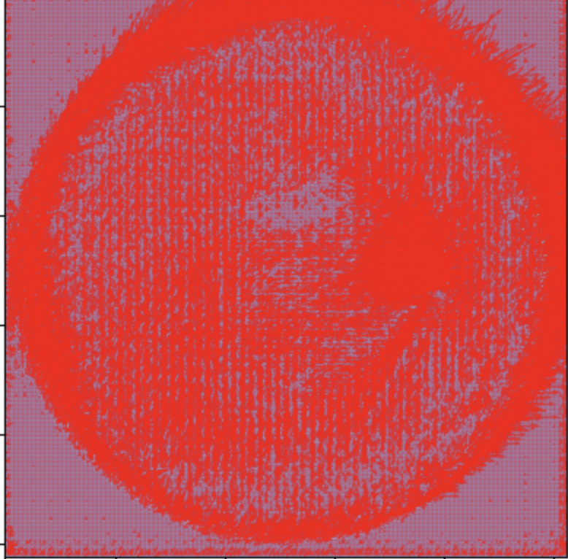
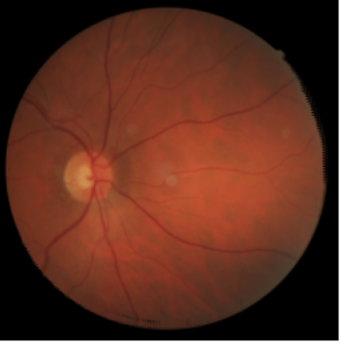
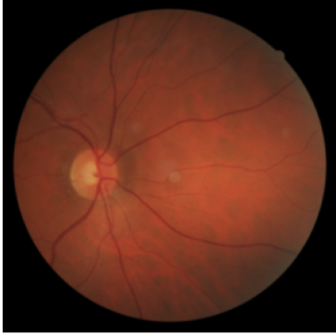


METHOD:
Moving image
Fixed image
fixed

Slide 6
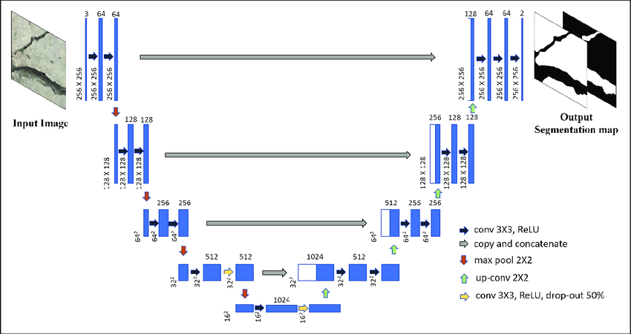
Unet Architecture :
6
φ
f,m

Slide 7
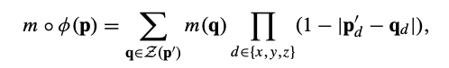



Spatial Transformation Function :
For each voxel p, we compute a pixel location p′ = p + u(p) in m
linearly interpolate the values
Z(p′) neighbours of p′, and d iterates over dimensions of .
d$∈\{x,y$}
f: fixed image, m: moving image , m ◦ φ : Registered Image, $φ$ : Registration Field

Slide 8
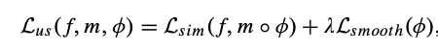
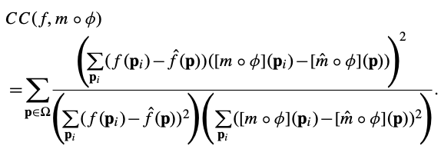
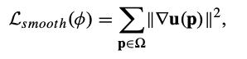
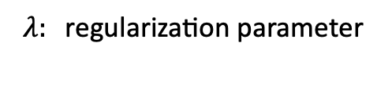
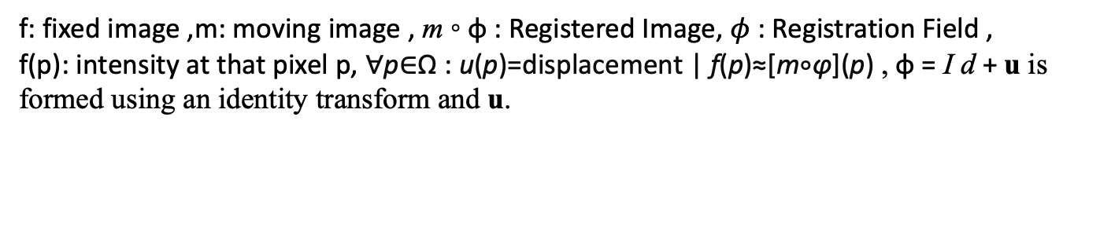
LOSS FUNCTION :Unsupervised Loss Function ( $L_{us}$(f,m,$φ)$)
$$λ: \text{regularization} \text{paramete}\text{r}$$
Local cross-correlation :
Smoothing Loss:
f: fixed image ,m: moving image , m ◦ φ : Registered Image, $φ$ : Registration Field ,
f(p): intensity at that pixel p, ∀p∈Ω : u(p)=displacement | f(p)≈[m∘φ](p) , φ = I d + u is formed using an identity transform and u.

Slide 9
Experiment :
Dataset:
FIRE: Fundus Image Registration Dataset
Hyper parameters:
Learning rate: 1e-4
Batch size: 1
Optimizer: Adam
Loss function: Unsupervised Loss Function
𝜆: regularization parameter - 0.01

Slide 10
Model Summary:
Input Image:
Shape: 1x256x256x6
Height: 256
Width: 256
Channels: 6
Batch size:1
Encoder :
conv_encode1:
Input: 6 channels
Output: 32 channels
Shape: 1x256x256x32
MaxPooling1:
1. Shape: 1x128x128x32
conv_encode2:
Input: 32 channels
Output: 64 channels
3. Shape: 1x128x128x64
MaxPooling2:
Shape: 1x64x64x64
5.conv_encode3:
Input: 64 channels
Output: 128 channels
Shape: 1x64x64x128
6.MaxPooling3:
Shape: 1x32x32x128
Bottleneck:
Convolutional Layers:
Input: 128 channels
Output: 256 channels
3. Shape: 1x32x32x256
Transposed Convolutional Layer:
Input: 256 channels
Output: 128 channels
Shape: 1x64x64x128

Slide 11
Model Summary
DECODER :
conv_decode3
Concatenation with previous encode path output (128 channels)
Input: 256 channels
Output: 64 channels
4. Shape: 1x64x64x64
Convolutional Layers:
Input: 64 channels
Output: 64 channels
Shape: 1x64x64x64
Transposed Convolutional Layer:
Input: 64 channels
Output: 32 channels
Shape: 1x128x128x32
4.conv_decode2:
Concatenation with previous encode path output (64 channels)
Input: 64 channels
Output: 32 channels
Shape: 1x128x128x32
5.Convolutional Layers:
Input: 32 channels
Output: 32 channels
Shape: 1x128x128x32
6.Transposed Convolutional Layer:
Input: 64 channels
Output: 32 channels
Shape: 1x256x256x32
Final layer:
1. Input: 32 channels
2. Output: 2 channels
3. shape: 1x256x256x2
Output:
(DEFORMATION MATRIX)
Shape: 1x256x256x2.
Height: 256
Width: 256
Channels: 2

Slide 12
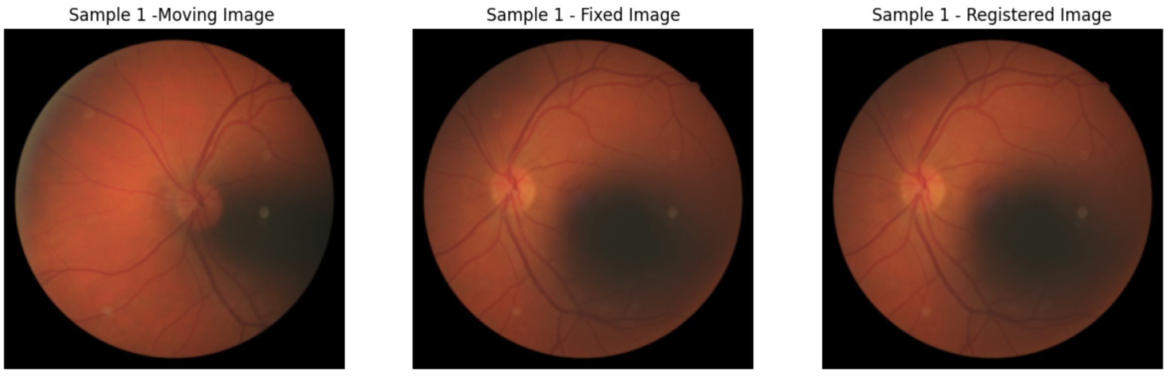
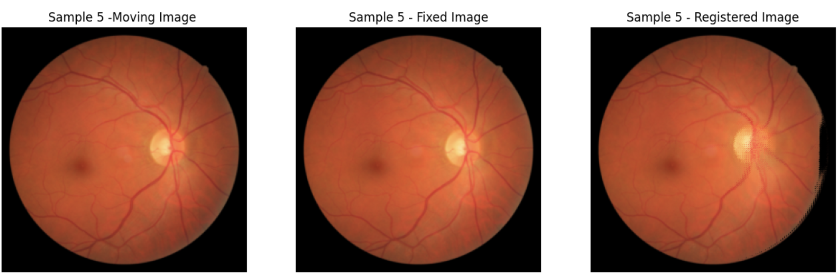
RESULTS:

Slide 13
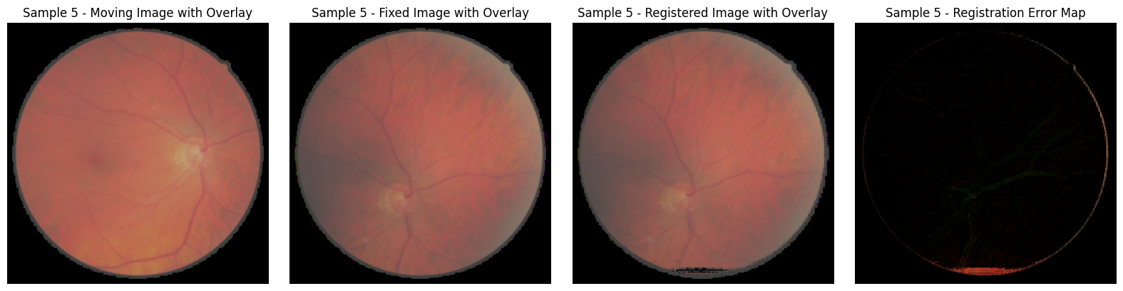
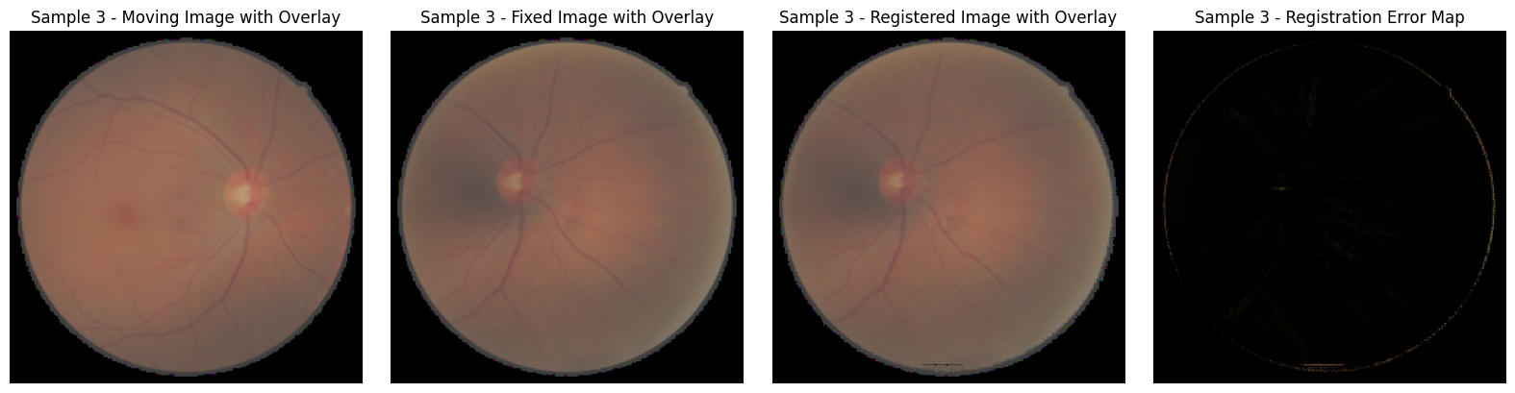
Results :

Slide 14
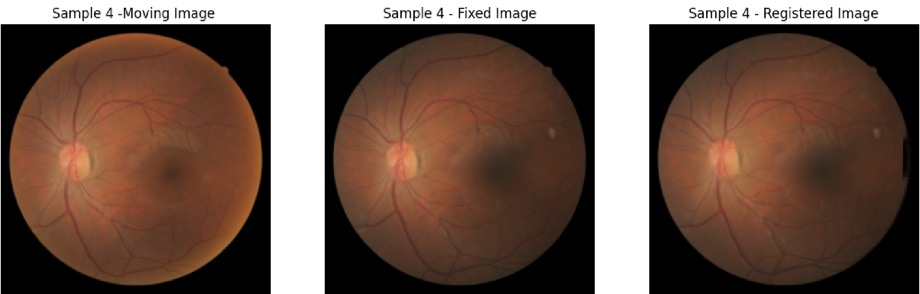
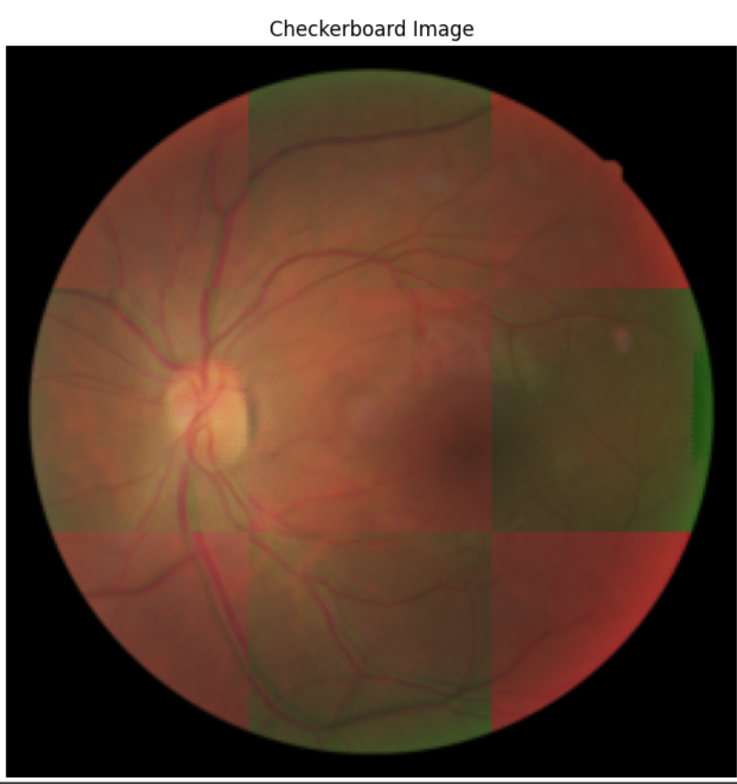
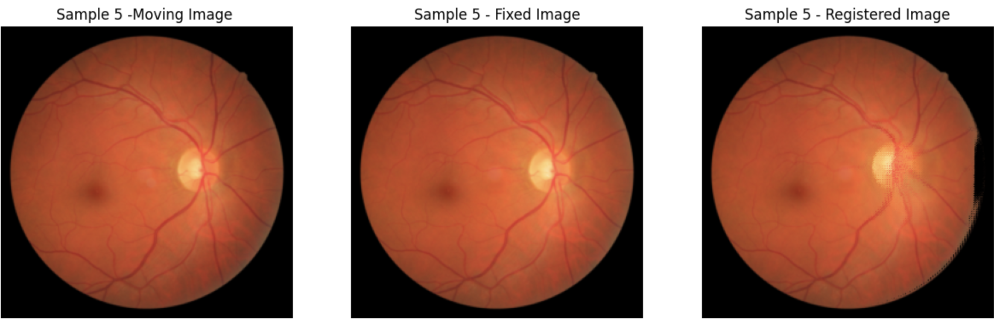
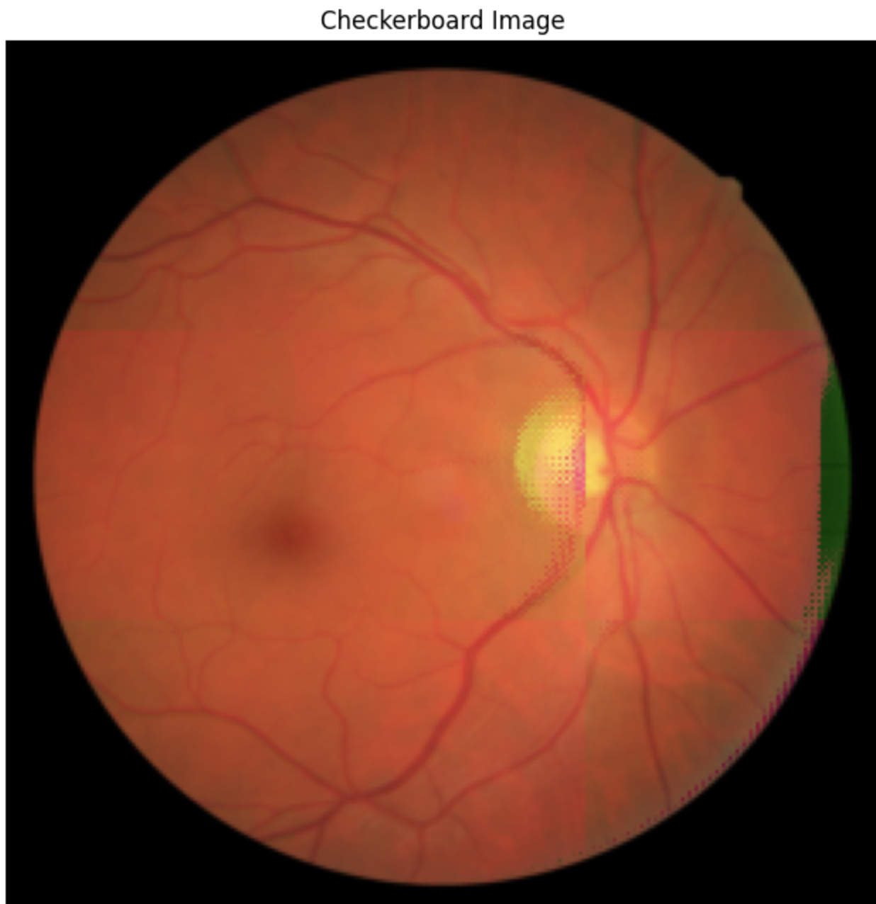
RESULTS : (with checkerboard image)

Slide 15
Conclusion:
Here we have done image registration using CNN and spatial transformer network
Compared to traditional methods voxel morph works better than traditional methods.

Slide 16
References :
VoxelMorph: A Learning Framework for Deformable Medical Image Registration Guha Balakrishnan , Amy Zhao, Mert R. Sabuncu, John Guttag, and Adrian V. Dalca
A. Sotiras, C. Davatzikos, and N. Paragios, “Deformable medical image registration: A survey,” IEEE Trans. Med. Imag., vol. 32, no. 7, pp. 1153–1190, Jul. 2013.
O. Ronneberger, P. Fischer, and T. Brox, “U-net: Convolutional net- works for biomedical image segmentation,” in Proc. Int. Conf. Med. Image Comput. Comput.-Assist. Intervent. (MICCAI). Cham, Switzer- land: Springer, 2015, pp. 234–241.

Slide 17
THANK YOU

